Slide 1
Simple Line Drawing
DDA (Digital Differential Analyzer)

Slide 2
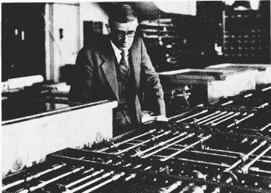
The DDA Algorithm
The digital differential analyser (DDA) algorithm takes an incremental approach in order to speed up scan conversion
Simply calculate y_{k+1} based on y_{k}
The original differential analyser was a physical machine developed by Vannevar Bush at MIT in the 1930’s in order to solve ordinary differential equations.

Slide 3
The DDA Algorithm (cont…)
Consider the list of points that we determined for the line in our previous example:
(2, 2), (3, 2³/₅), (4, 3¹/₅), (5, 3⁴/₅), (6, 4²/₅), (7, 5)
Notice that as the x coordinates go up by one, the y coordinates simply go up by the slope of the line
This is the key insight in the DDA algorithm

Slide 4
The DDA Algorithm (cont…)
When the slope of the line is between -1 and 1 begin at the first point in the line and, by incrementing the x coordinate by 1, calculate the corresponding y coordinates as follows: (for jogl x+=.01)
When the slope is outside these limits, increment the y coordinate by 1 and calculate the corresponding x coordinates as follows: (for jogl y+=.01)

Slide 5
The DDA Algorithm (cont…)
Again the values calculated by the equations used by the DDA algorithm must be rounded to match pixel values (don’t round for jogl)
(x_{k}+1, round(y_{k}+m))
(round(x_{k}+ ¹/_{m}), y_{k}+1)
(x_{k}, y_{k})
(x_{k}+ ¹/_{m}, y_{k}+1)
(x_{k}+1, y_{k}+m)
(x_{k}, y_{k})
(x_{k}, round(y_{k}))
(round(x_{k}), y_{k})

Slide 6
Task
Generate 10 random lines (pair of start and end points )
For every line sort the pair according to x values
Determine the slope
Implement the DDA algorithm

